Slide 1
Introduction

Slide 2

Contact

Slide 3
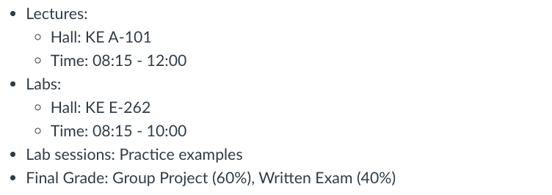
Essential Information

Slide 4
Lectures, Labs, Exam, & Project

Slide 5
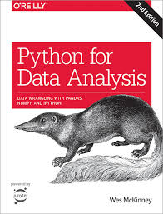
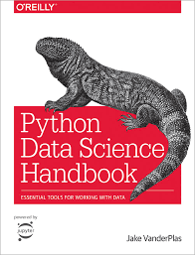
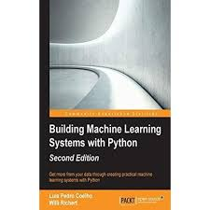
Course Materials
Textbook: Python for Data Analysis 2nd Edition, McKinney, O'Reilly ISBN: 978-1491957660
Python Data Science Handbook, VanderPlas, O'Reilly ISBN: 978-1491912058 (OPTIONAL)
Building Machine Learning Systems with Python 2nd Edition, Coelho and Richert, PACKT ISBN: 978-1784392772 (OPTIONAL)

Slide 6
Prerequisites
Basic Math Skills
Algebra
Statistics and Probability
Programming Knowledge

